Slide 1
SALARY PREDICTOR
CAPSTONE PROJECT
Presented By:
1. Student Name- GOURAB GORAI
2. COLLEGE NAME – DR. B. C. ROY ACADEMY OF PROFESSIONAL COURSES
3. AICTE ID :- STU65f3159ce3fe81710429596
4. DEPT. :- BCA

Slide 2
OUTLINE
Problem Statement (Should not include solution)
System Development Approach (Technology Used)
Algorithm & Deployment (Step by Step Procedure)
Result
Conclusion
Future Scope(Optonal)
References

Slide 3
Problem Statement
Problem Statement: Salary Prediction Web Application Using Machine Learning
Modern job seekers and HR professionals often struggle to estimate fair and accurate salaries based on various candidate attributes such as education, experience, location, and job title. This lack of transparency can lead to misaligned expectations and hiring inefficiencies. The goal of this project is to develop a user-interactive Flask web application that predicts a candidate’s salary using machine learning. The application must:
Validate user inputs rigorously (e.g., age-experience consistency, missing fields).
Train a Random Forest Regression model using historical salary data.
Evaluate the model using R² score, MSE, and visualizations like residual plots and feature importance charts.
Handle missing or malformed datasets gracefully.
Display predictions along with graphical insights to enhance interpretability.
The system serves as a robust decision support tool for individuals and organizations by ensuring reliable predictions and real-time model feedback through a web interface.

Slide 4
System Approach
System Requirements
Hardware:
Processor: Intel i3 or higher
RAM: Minimum 4 GB
Storage: Minimum 100 MB for datasets and dependencies
Software:
Python 3.7 or above
Web browser (for accessing Flask app locally)
Operating System: Windows/Linux/macOS

Slide 5
System Approach
Libraries and Frameworks Used
Flask: Web framework to build the interactive UI
Pandas: Data manipulation and preprocessing
NumPy: Numerical operations
Matplotlib & Seaborn: For generating evaluation plots
scikit-learn (sklearn)
Implementation Strategy
Model Training: On valid dataset using a Random Forest Regression pipeline
User Interface: Accepts form inputs via Flask and validates them
Salary Prediction: On-the-fly predictions using trained model
Evaluation: Generates plots like Actual vs Predicted, Residuals, Feature Importance
Error Handling: Displays user-friendly messages for invalid inputs or system errors

Slide 6
Algorithm & Deployment
Step-by-Step Procedure:
Data Collection
Load the dataset.
Data Preprocessing
Check for missing or malformed entries.
Convert categorical features using OneHotEncoding.
Validate numerical fields
Age > 0 and < 100
Experience ≥ 0 and ≤ 70
Logical consistency between age and experience.

Slide 7
Algorithm & Deployment
Model Building
Split the dataset into training and testing sets using an 80:20 ratio.Use RandomForestRegressor wrapped inside a Pipeline that includes the preprocessing steps.
Train the model on the training data.
Model Evaluation
Predict salaries on the test set.Evaluate the model using:R² Score
Mean Squared Error (MSE)
Generate the following plots for model analysis:
Line Plot: Actual vs Predicted Salaries
Histogram: Distribution of Residuals
Bar Chart: Feature Importance
Scatter Plot: Actual vs Predicted Salaries
Web Application Integration
Build a web interface using the Flask framework. Allow users to enter details through an HTML form.Validate user inputs on the server side.Use the trained model to predict salary based on the user's inputs.Display the predicted salary and relevant evaluation plots.

Slide 8
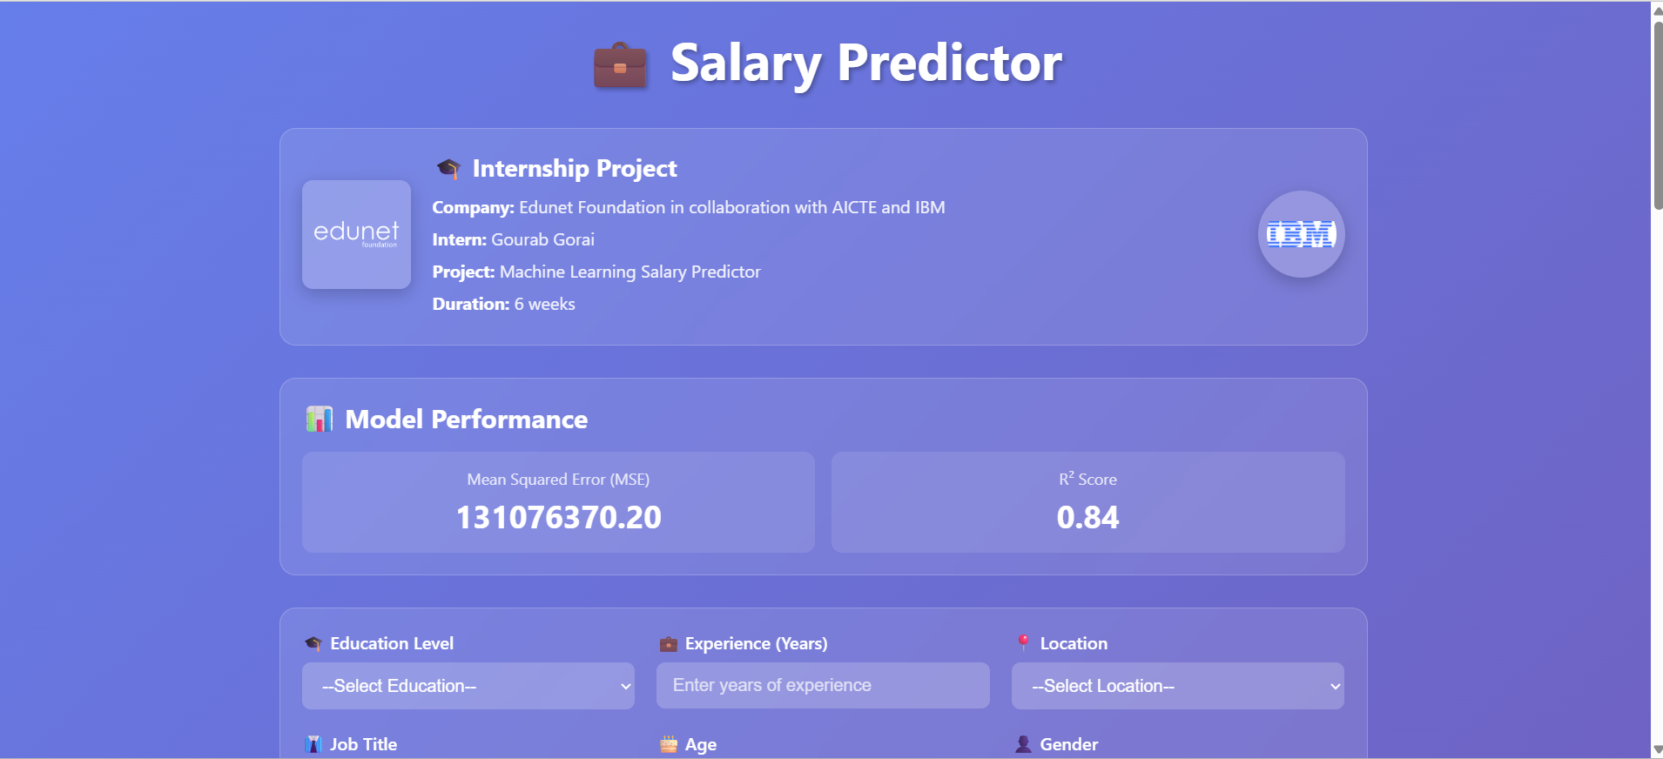
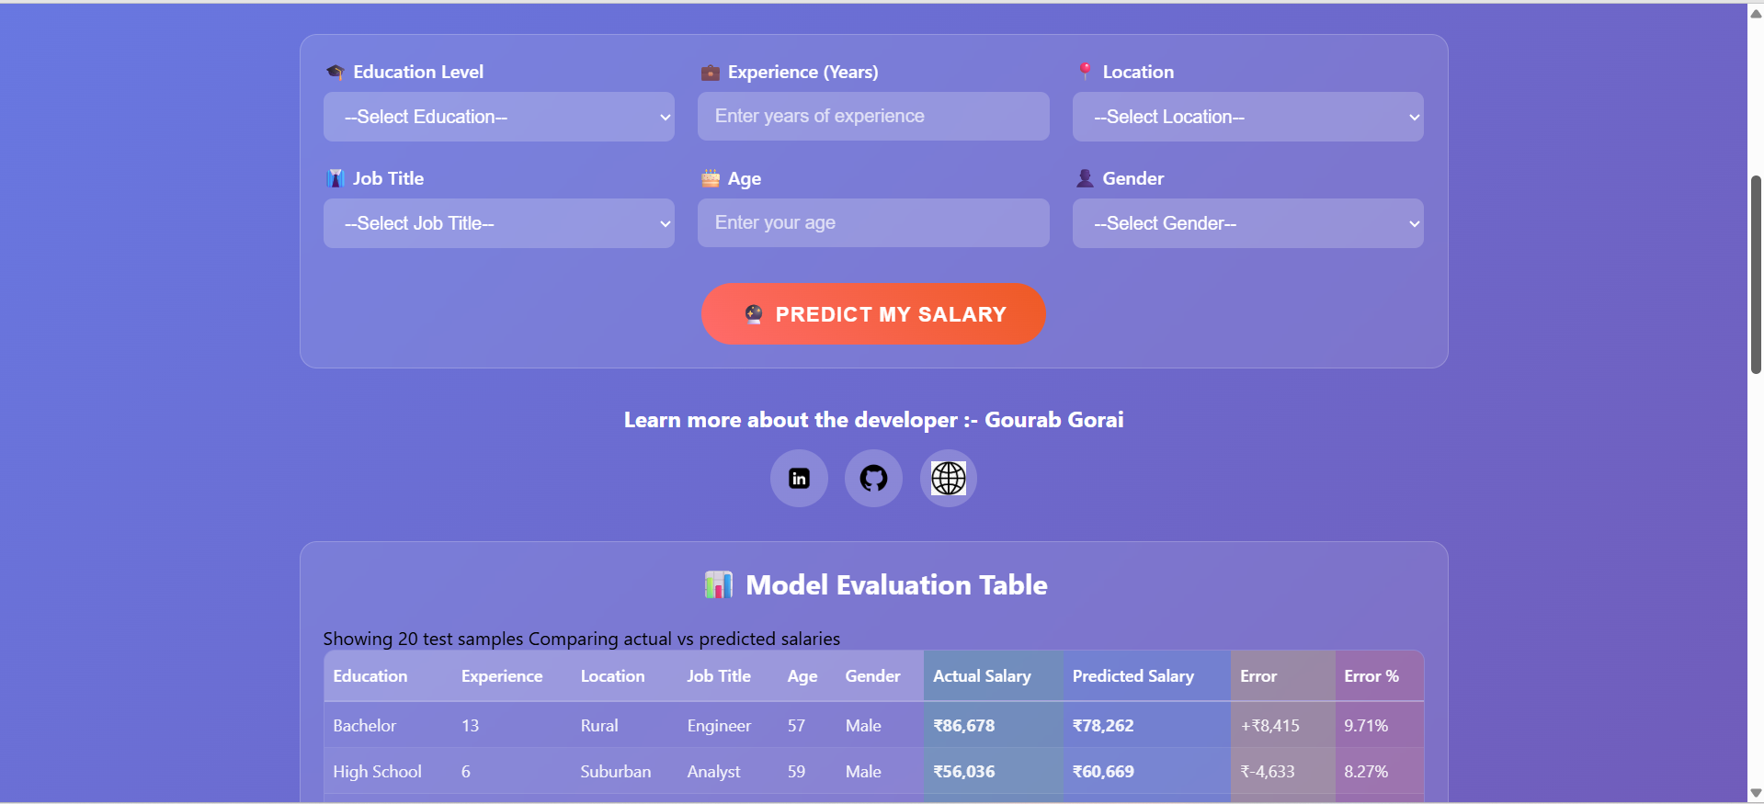
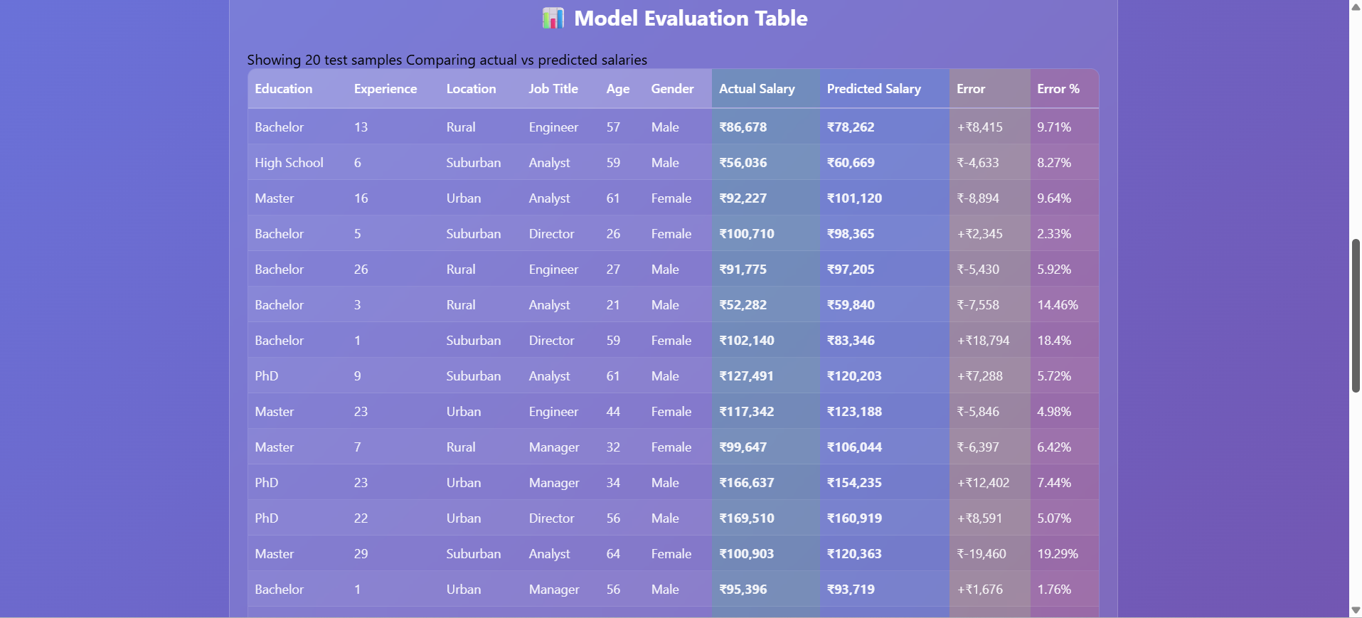
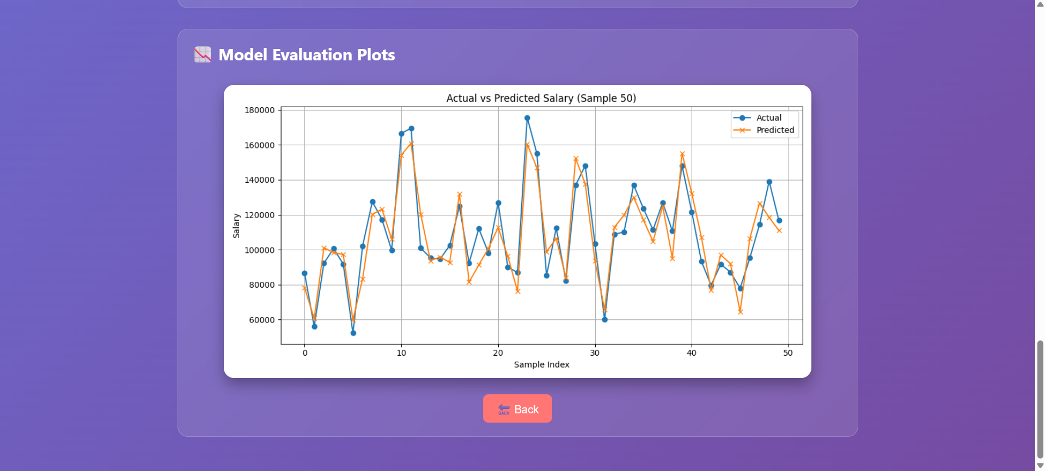
Result

Slide 9
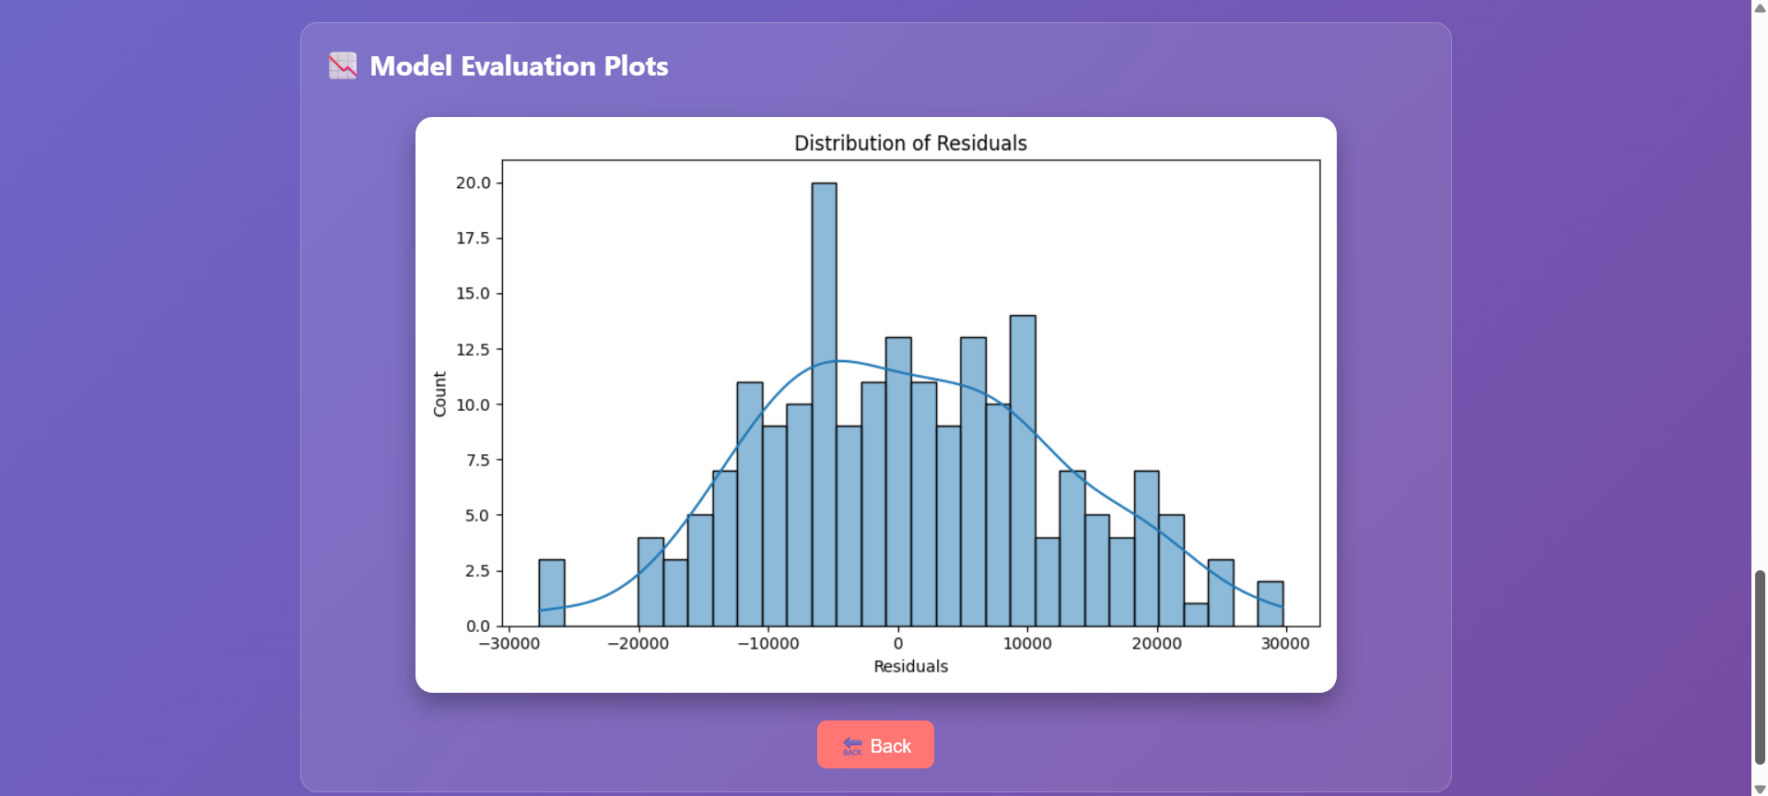
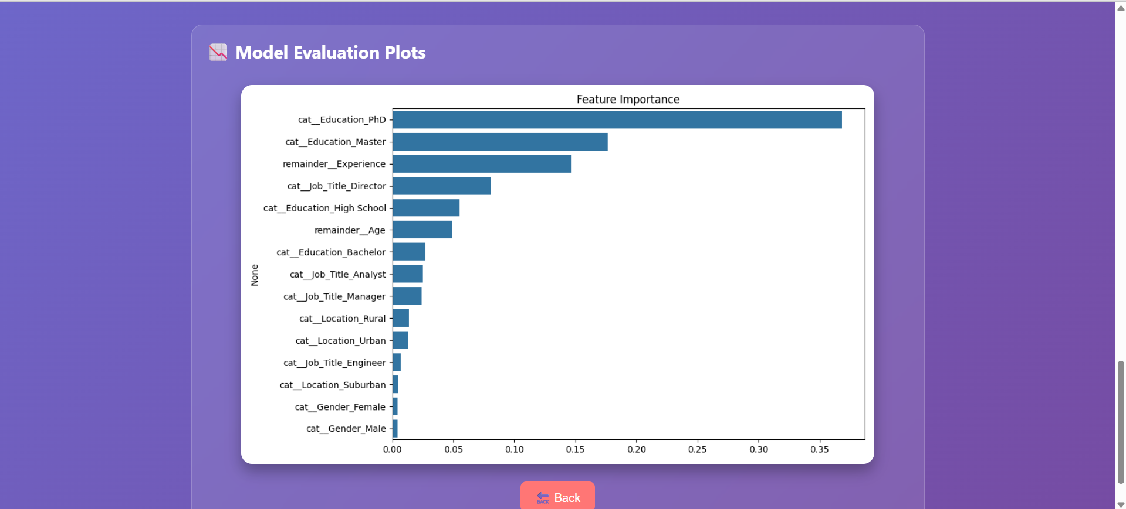
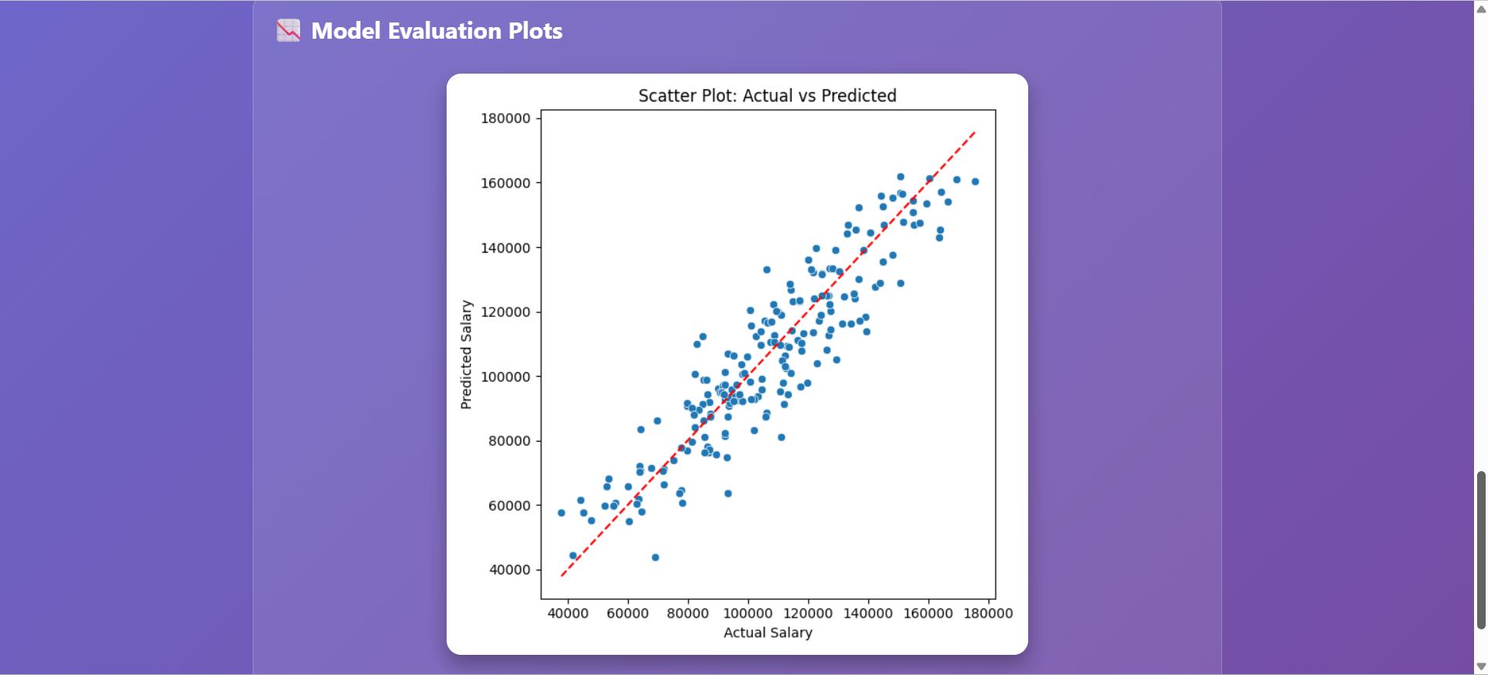
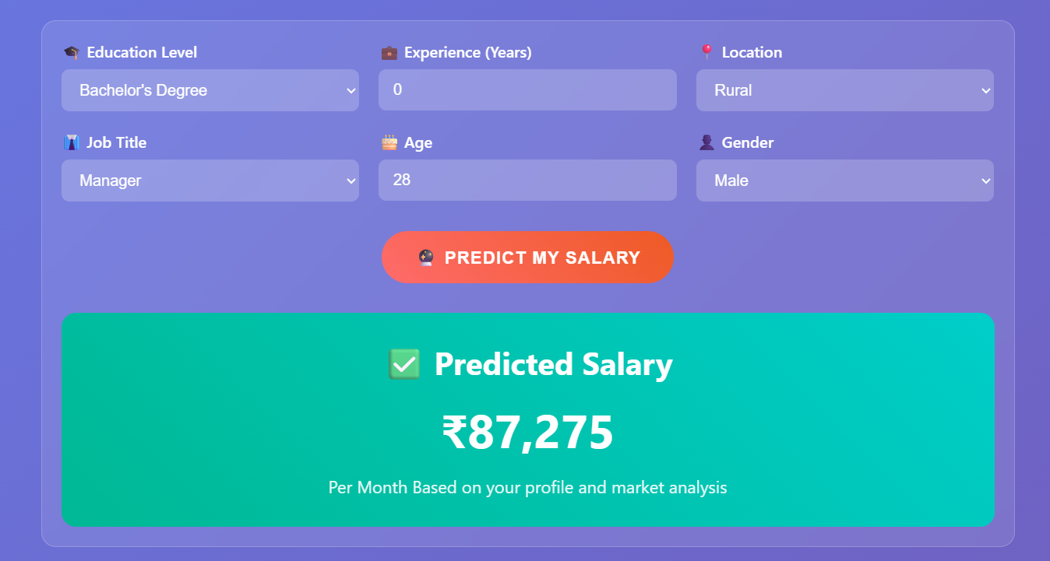
Result

Slide 10
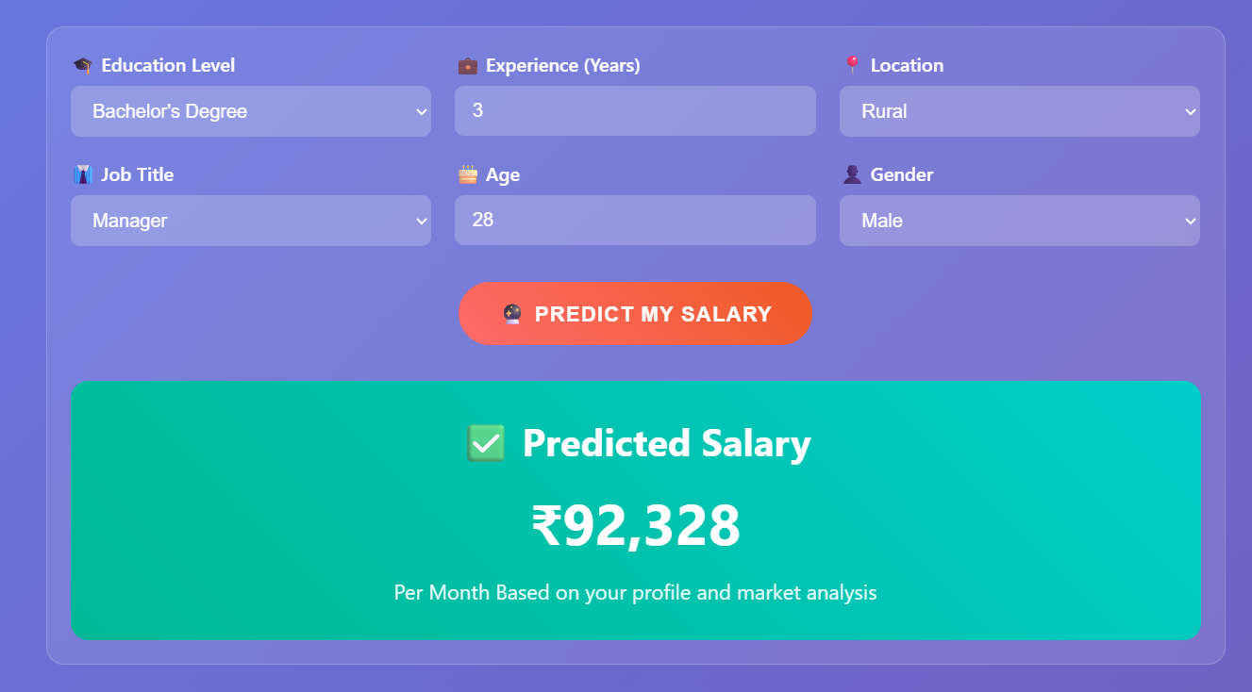
Result
Github :- https://github.com/GourabGorai/IBMInternshipProject

Slide 11
Conclusion
The Salary Prediction Web Application successfully demonstrates the integration of machine learning with a user-friendly web interface to predict employee salaries based on various demographic and professional attributes. The Random Forest Regression model, combined with appropriate preprocessing and validation, delivers reasonably accurate predictions, as reflected by the R² score and error metrics. The inclusion of visual plots like actual vs. predicted salaries, residual distributions, and feature importance enhances interpretability for end-users.
During the development, some key challenges were:
Ensuring logical consistency between age and experience inputs.
Managing invalid or missing entries in user-submitted data.
Generating meaningful insights from limited or noisy datasets.
Handling errors and edge cases during real-time predictions and plotting.
Despite these, the project achieved its core objective: providing reliable salary predictions with visual feedback and error-handling mechanisms.

Slide 12
References
Flask Documentation – https://flask.palletsprojects.com/
Scikit-learn Documentation – https://scikit-learn.org/stable/
Matplotlib Documentation – https://matplotlib.org/stable/contents.html
Seaborn Documentation – https://seaborn.pydata.org/
Stack Overflow – Community discussions and solutions related to Flask and ML deployment.
Kaggle Datasets – For accessing various salary prediction datasets: https://www.kaggle.com/datasets
W3Schools – For basic HTML and CSS used in Flask templates: https://www.w3schools.com/
Python Official Documentation – https://docs.python.org/3/

Slide 13
THANK YOU

